Slide 1
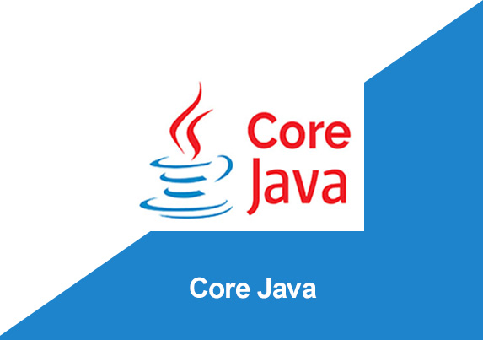
By: Manas Tuwani

Slide 2
METHODS
A method is a block of code or collection of statements, or a set of code grouped together to perform a certain task or operation. It is used to achieve the reusability of code.
In general, a method is a way to perform some task. Similarly, the method in Java is a collection of instructions that performs a specific task. It provides the reusability of code. We can also easily modify code using methods.
If any logic is reusable for multiple times, we are identifying that logic and make it as method or function. Here after whenever we require that logic, instead of writing that logic again and again simply we are calling the methods.
“A group of statements, set of logic which we can reuse for multiple times is called method.”

Slide 3
Predefined Method in Java
In Java, predefined methods are the method that is already defined in the Java class libraries is known as predefined methods.
It is also known as the standard library method or built-in method. We can directly use these methods just by calling them in the program at any point. Some pre-defined methods are length(), equals(), compareTo(), charAt() etc.

Slide 4
User Define Method in Java
The method written by the user or programmer is known as a user-defined method. These methods are modified according to the requirement.

Slide 5
Types of Methods in Java
There are 2 different methods available in java
1. Static method
2. Non-static method

Slide 6
Static Method
Static methods are creating inside the class and static methods are loading while class is loading and we can access these methods directly within the class, “classname.method” name in different class and “classname.methodname” in different package.
Note: we can declare static method with ‘static’ keyword.

Slide 7
Non-static Methods
Non-static methods also creating inside the class and these are loading while object is creating, that’s why non-static methods we can access only by creating the object.

Slide 8
Note:
In one class we can create any number of methods (Both Static and Non-Static) but execution starts only from main method.

Slide 9
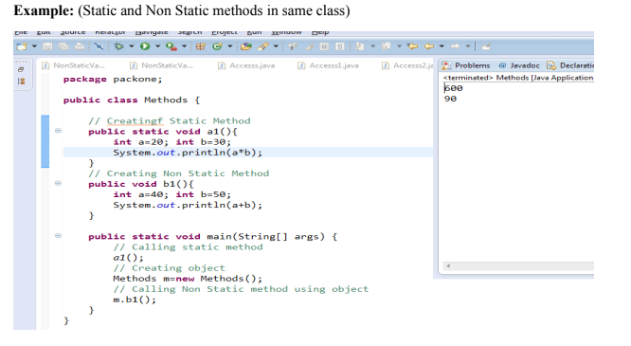

Slide 10
Methods with Arguments/Parameters
Sometimes we need to execute the same methods multiple times with different data. In that case we are creating methods with arguments so that while accessing the methods we can pass the data into methods through arguments.
Note:
Methods we can create with arguments are either static or non static methods. Only the way we are calling is different from Static to Non Static.

Slide 11
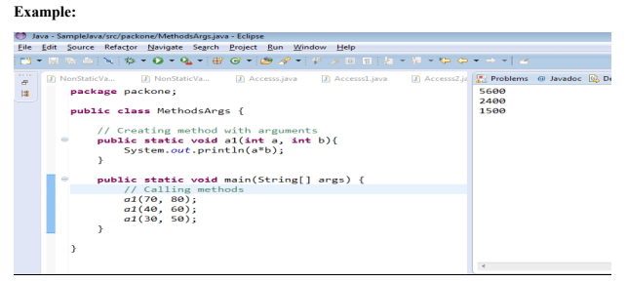

Slide 12
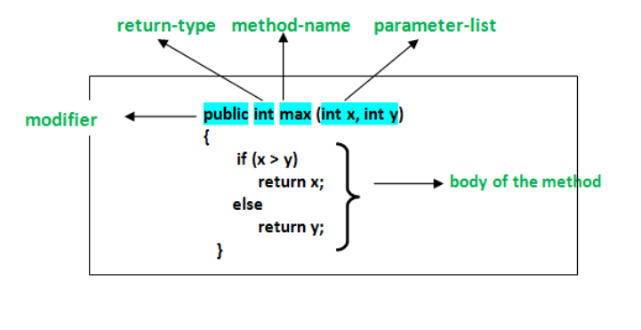
Method Declaration
The method declaration provides information about method attributes, such as visibility, return-type, name, and arguments. It has six components that are known as method header.

Slide 13
Advantages of Method/Functions
Code Reusability
Code Optimization
Code Readability
Method are useful in hiding implementation details.
It is easier to edit any program which is written in any programming language.

Slide 14
Method Overloading
Sometimes we are creating same method name with different arguments. When we are calling
method, we can differentiate method based on the arguments.
In one class we are creating multiple methods with same name, but different arguments is called Method Overloading

Slide 15
